Slide 1
Predicting Dyslexia
Machine Learning to detect Dyslexia from eye movements
Harinee Madhusudhan

Slide 2
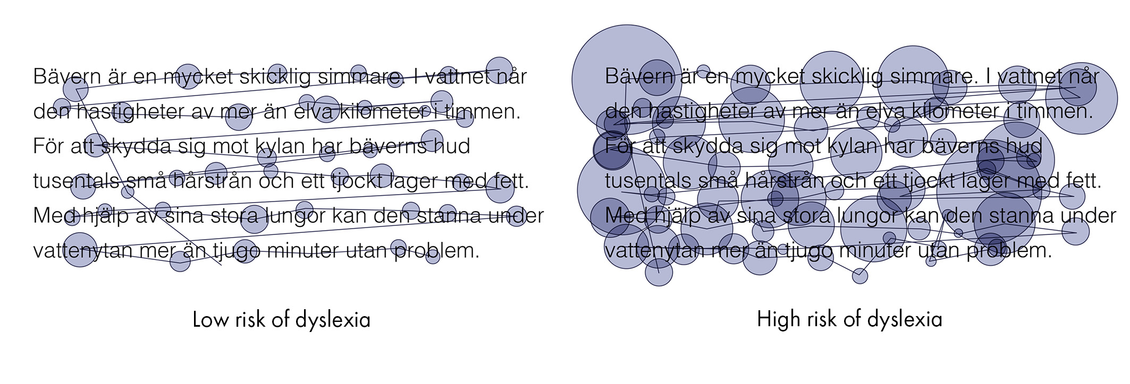
Business Problem
Dyslexia is a language-based learning disability
Eye Movement readings can be highly predictive of reading ability
Eye tracking is an efficient means to identify children at risk
The eye movement is measured using
Fixation: where the eye is kept aligned with the target for a certain duration
Saccade: eye movement to move rapidly from one point of interest to another
Dyslexic individuals exhibit
longer duration of fixations,
shorter saccades and
more fixations in reading

Slide 3
Data Input and Sources
Data was based on eye tracking data from 185 subjects
Collected from a Swedish school, between 1989 and 2010
A goggle-based infrared corneal reflection system was used to track eye position over time
The horizontal and vertical position of both eyes were sampled.
97 High Risk subjects (76 males and 21 females) and 88 Low Risk subjects (69 males and 19 females).
LX: X movement of left eye
LY: Y movement of left eye
RX: X movement of right eye
RX: Y movement of right eye
T | LX | LY | RX | RY
0 | 0 | 0 | 0 | 0
20 | 2.00E-05 | -0.65537 | -1.00E-05 | -0.65536
40 | -0.65536 | -0.65538 | -1.00E-05 | -0.65538
60 | 6.55365 | -2.62153 | 17.03959 | -3.93229
80 | 22.28258 | -4.58769 | 22.28257 | -2.62158
100 | 21.62721 | -1.96621 | 22.2826 | -1.96621
120 | 22.2826 | -1.96622 | 22.28256 | -1.31086
140 | 22.28256 | -1.96622 | 22.93792 | -1.31086
160 | 22.93795 | -1.96622 | 22.93791 | -0.65549
180 | 22.93794 | -1.31086 | 22.93791 | -0.6555
200 | 22.93793 | -1.31087 | 22.9379 | -0.6555

Slide 4
Data Wrangling
From the individual eye movement data for each subject the following data items were computed:
The sum, mean and count of the distance moved by the left & right eyes
The sum, mean and count of the duration of Left and Right eyes horizontal and vertical movements in the left and right directions
The sum, mean and count of durations of no movements for both eyes
An additional variables was gender
In total there were 53 variables used in the model.

Slide 5
Data Inference
Comparing the left and right eye movements for control vs dyslexic groups, it is seen that
Dyslexic groups have more fixations and more saccades.
The distance traveled is slightly more for dyslexic groups
The sum of the horizontal/vertical distances by the dyslexic group as well as the count of horizontal/vertical distances by the dyslexic group are higher than the control group.
But the mean distance traveled by the horizontal/vertical movements is about the same.

Slide 6
Model Details
Dependent Variable
The column label is the prediction. 0 is control group and 1 is dyslexic group.
Independent Variables
There are 52 independent variables. All but gender are numerical/decimal variables.
Model Training Data
The dataset has 88 subjects in the control group and 97 subjects in the dyslexic group.
The data seems to be very balanced.
Model Parameters
Liblinear Logistic regression model with
a regularization parameter (C) of 10 and
a maximum of 500 iterations.

Slide 7
Model Performance, Results and Conclusion
For the training set, the model fit is pretty good.
The precision and recall are both 1, so 100% precision and recall. The training is pretty good.
For the test set, the precision is 0.96 for the normal group and 0.90 for the dyslexic group. This means, 96% subjects in the control group will be correctly identified and 90% of the subjects in dyslexic group will be correctly identified.
For the test set, the recall is 89% for the control group and 97% for the dyslexic group, the model will be right 89% of the time while predicting a subject in the control group and will be right 97% of the time while predicting a dyslexic group.
The ROC obtained was 96%, ensuing that the model fit is good.

